Slide 1


Slide 2
Understanding API Gateway
Managing Communication in Modern Architectures

Slide 3
What is an API Gateway?
An API Gateway is a server that acts as an intermediary between clients and backend services, managing API calls, authentication, and traffic.
Core Functions:
Request routing
Authentication and authorization
Rate limiting
Caching
Monitoring and analytics
Real-World Examples: AWS API Gateway, Kong, Apigee, NGINX

Slide 4
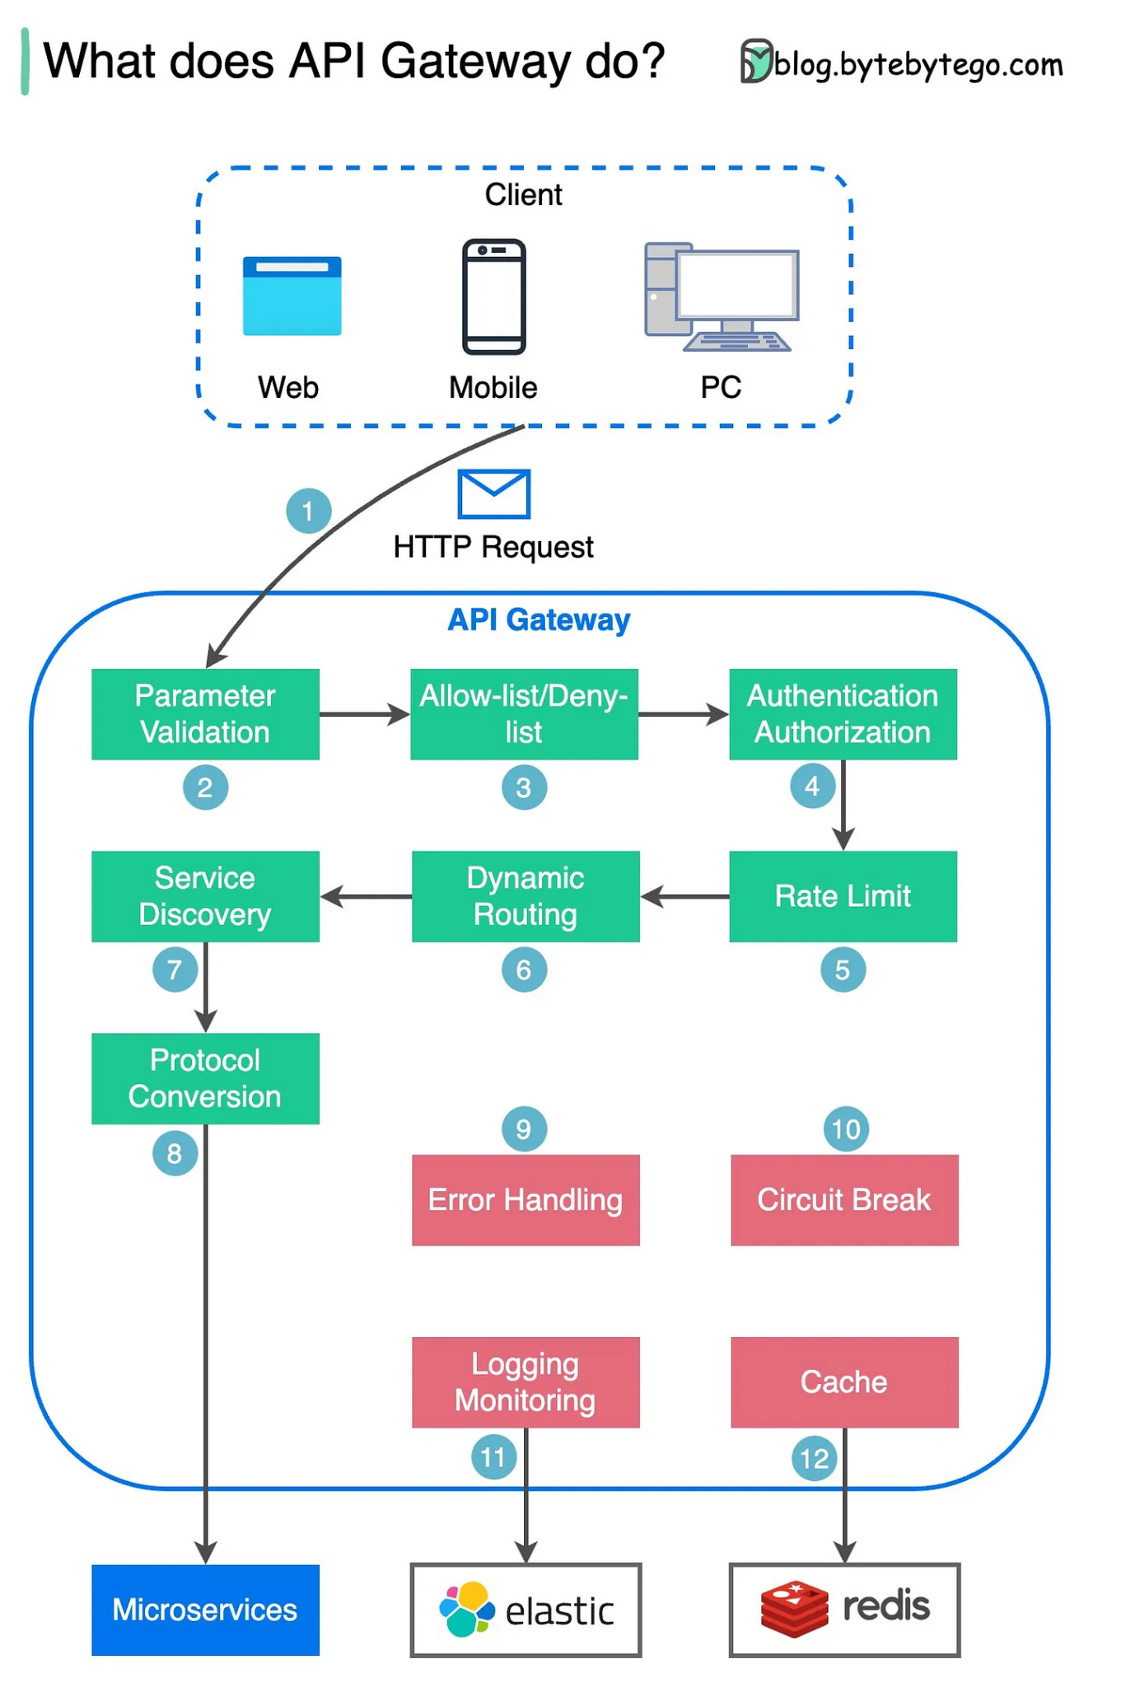

Slide 5
Why Use an API Gateway?
Simplified Client Interaction: Combines multiple APIs into a single interface.
Enhanced Security: Centralized authentication and authorization mechanisms.
Scalability: Distributes traffic across backend services.
Monitoring: Tracks usage patterns and performance metrics.
Performance Optimization: Provides caching to reduce latency.

Slide 6
Architecture of API Gateway
Client: Sends requests to the API Gateway.
API Gateway: Processes the request, applies security checks, and routes it to the appropriate backend service.
Backend Services: Handle the actual functionality, such as database queries or business logic.
Response Flow: Backend -> API Gateway -> Client

Slide 7
Key Features of an API Gateway
Authentication and Authorization: Ensures secure access to APIs.
Rate Limiting: Prevents abuse by limiting the number of requests.
Load Balancing: Distributes incoming requests across multiple backend services.
Caching: Reduces response times for repeated requests.
Traffic Shaping: Prioritizes specific API requests based on policies.
Monitoring and Analytics: Tracks performance and identifies bottlenecks.

Slide 8
API Gateway vs Reverse Proxy
API Gateway:
Manages multiple APIs.
Provides additional features like authentication, monitoring, and caching.
Specifically designed for API ecosystems.
Reverse Proxy:
Handles requests and forwards them to servers.
Primarily used for load balancing and SSL termination.
Key Difference: API Gateways are specialized for API management, while reverse proxies are general-purpose tools.

Slide 9
Benefits of Using API Gateways
Centralized API Management: Easier to manage and monitor multiple APIs.
Improved Security: Single point for implementing security protocols.
High Availability: Reduces downtime with load balancing.
Enhanced User Experience: Faster response times with caching.
Seamless Integration: Supports diverse backend services.

Slide 10
Common Use Cases for API Gateways
Microservices: Manages communication between services.
Serverless Applications: Routes traffic to serverless functions.
Mobile Applications: Simplifies backend interactions for mobile apps.
IoT Devices: Handles high traffic from IoT devices efficiently.
Third-Party Integrations: Provides a unified interface for external APIs.

Slide 11
Best Practices for API Gateways
Secure API Endpoints: Implement strong authentication mechanisms.
Enable Logging and Monitoring: Track API usage and performance.
Optimize Caching: Reduce latency and improve performance.
Set Rate Limits: Prevent abuse and ensure fairness.
Plan for Scalability: Design the gateway to handle traffic spikes.
Documentation: Provide clear guidelines for developers.

Slide 12
Real-World API Gateway Providers
AWS API Gateway: Fully managed service for building and deploying APIs.
Kong: Open-source gateway with advanced plugins.
Apigee: Google’s API management solution.
NGINX: Combines reverse proxy with API management features.
Azure API Management: Integrates seamlessly with Azure services.

Slide 13
Conclusion
Key Points:
API Gateways centralize and secure API traffic management.
They play a crucial role in modern architectures like microservices.
Action Item: Explore API Gateway solutions for your next project.

